Slide 1
Cone Top Design Carl Hernandez
Utilizing Neodymium magnets and low-cost Microprocessors to develop practical products for use in road crew safety instruments for traffic cones.

Slide 2
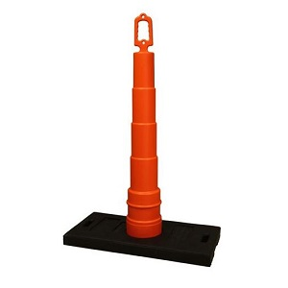
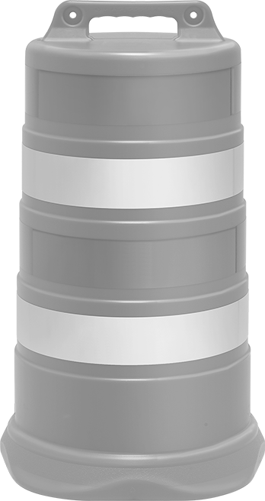
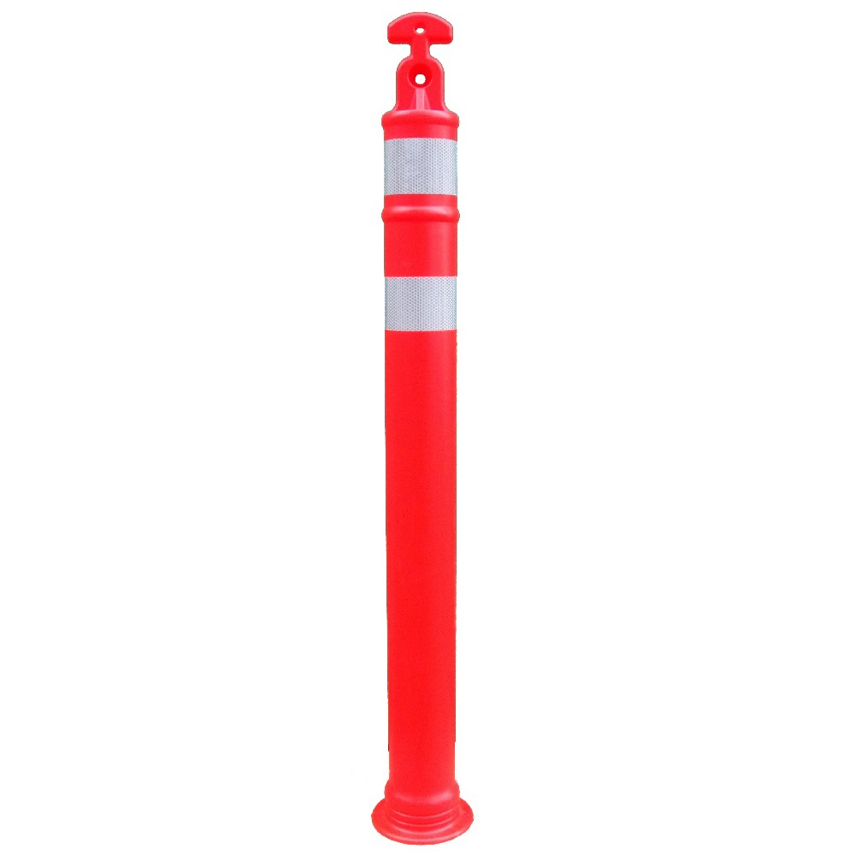
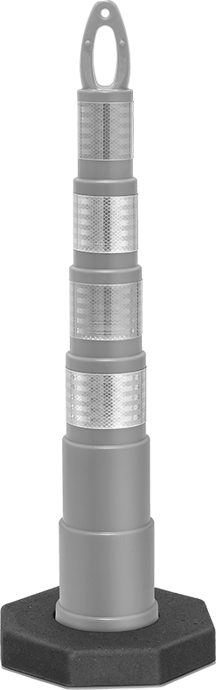
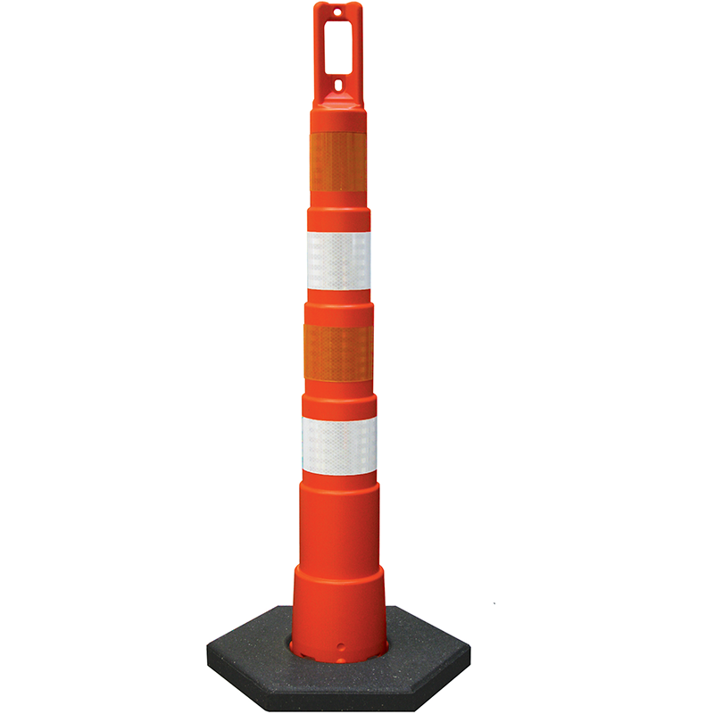
Cone designs
They all have holes for mounting lights!

Slide 3
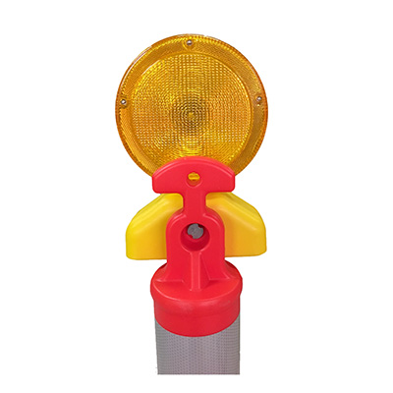
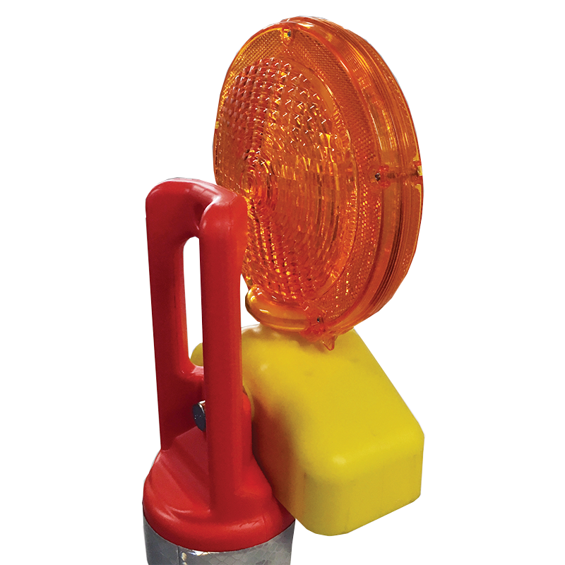
Current Designs to reuse. Don’t reinvent the wheel.
Proposal: Reuse existing designs to integrate with our modular design to reduce number of man-hours spent on project

Slide 4
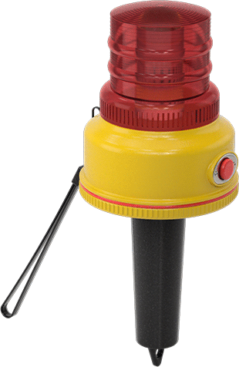
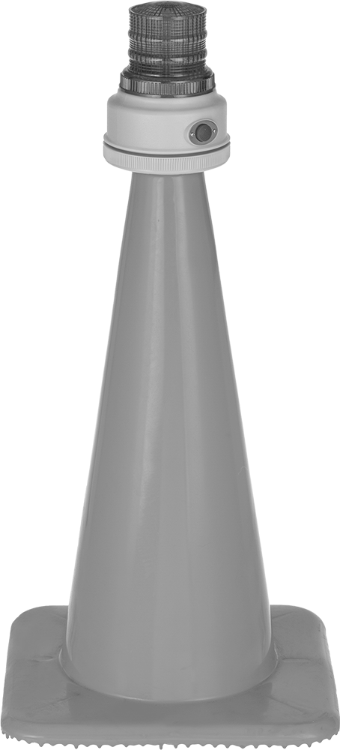
For Regular Cones, use similar existing designs.
Using the slightly angled cylindrical design is beneficial since it is already being produced, and thus, would be easier to mass produce.

Slide 5
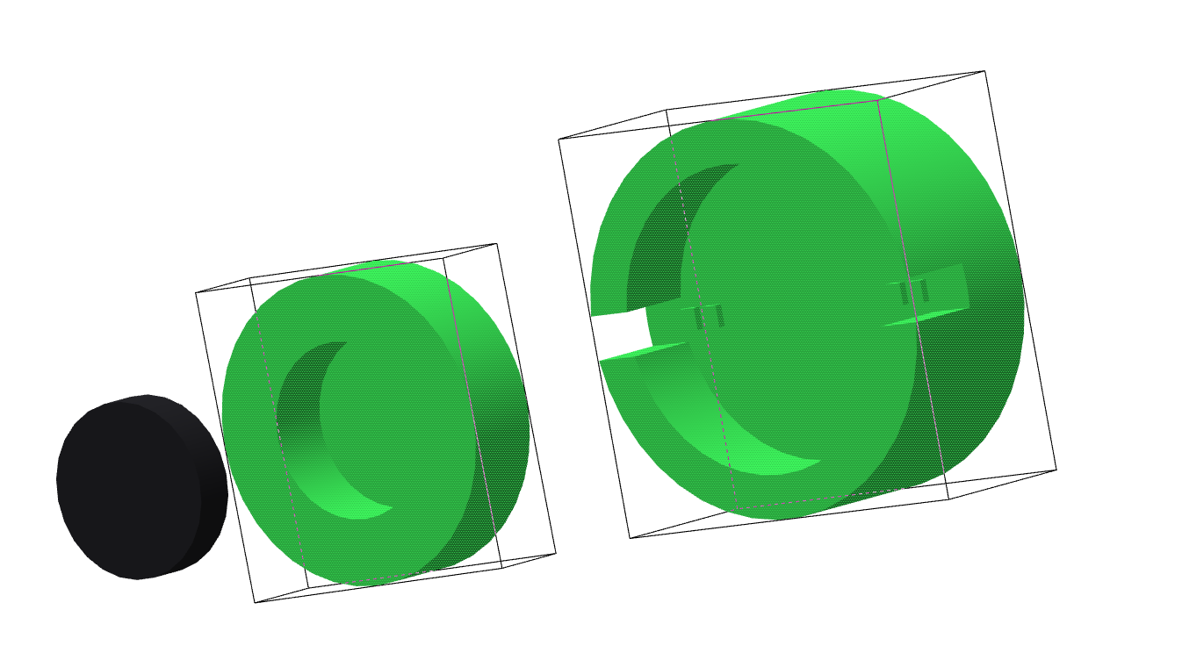
Actual product Concept:
Base of Cone Topper Light System
Magnet will also be in this part.
Charging mechanism.
Use magnet to hold in place while charging
Magnet is also used to attach to modular designs for different cone types
Charging block that is in base station
Magnet Glued in place

Slide 6
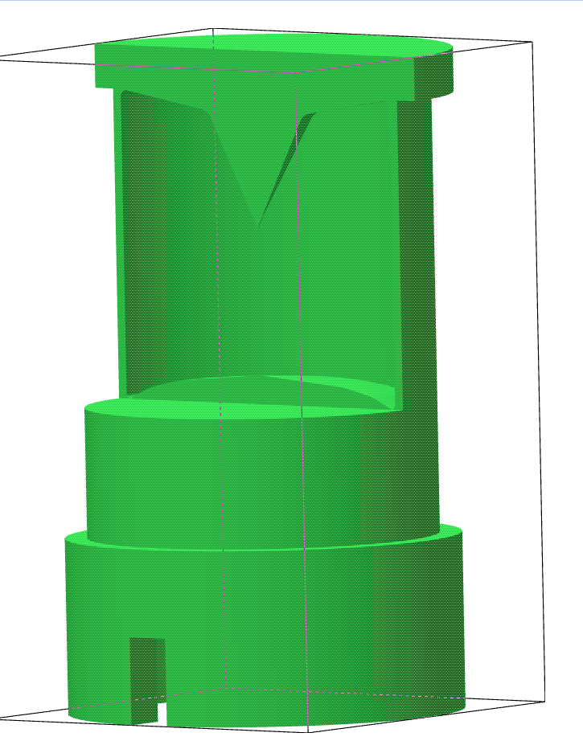
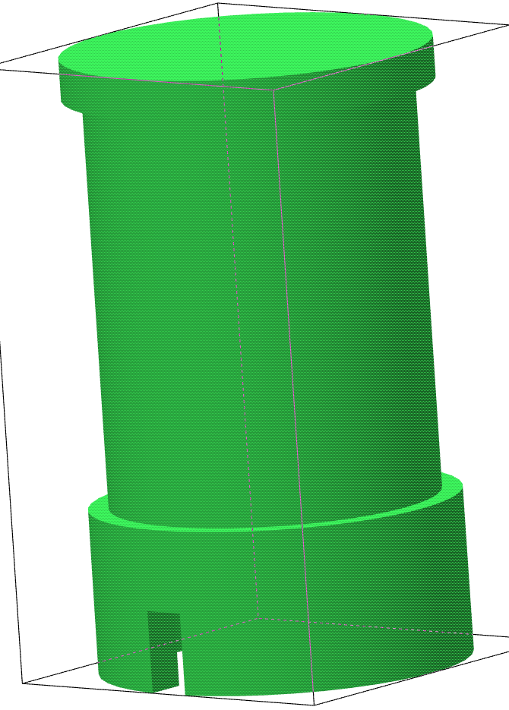
Whole Cone Topper Concept
The cone would have an upward facing LED with a mirrored surface on the upper side to create the illusion of 360-degree light.
The final design can be change to have less space between the mirror and the LED, but in the modeled design, there is about 1.4 inches of z-height to add electronics, with a radius of 2 inches.
LED

Slide 7
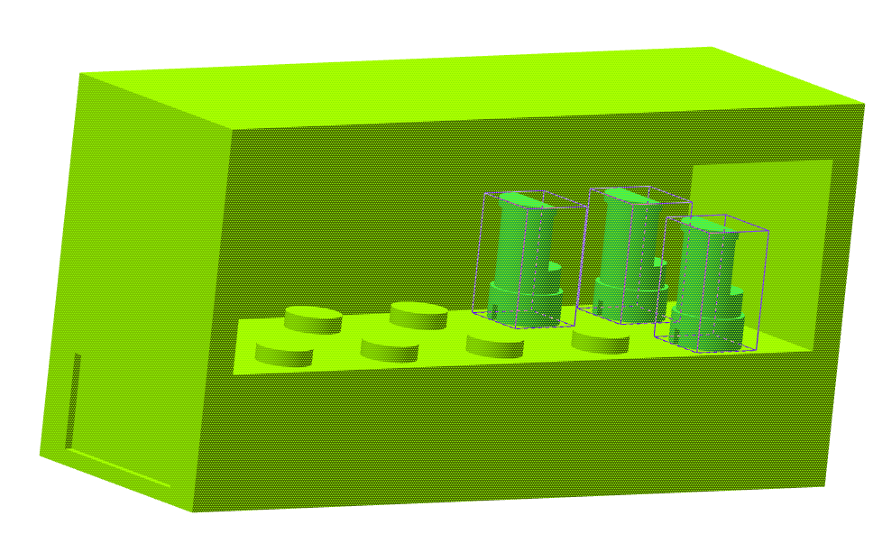
Charging/Sound Base
Total dimensions are 8*24*12 inches.
The design shown here would have space for charging 10 cone-toppers, and a rectangular space of 8*24*5 inches would be allocated to electronics, including battery and speaker.

